Slide 1
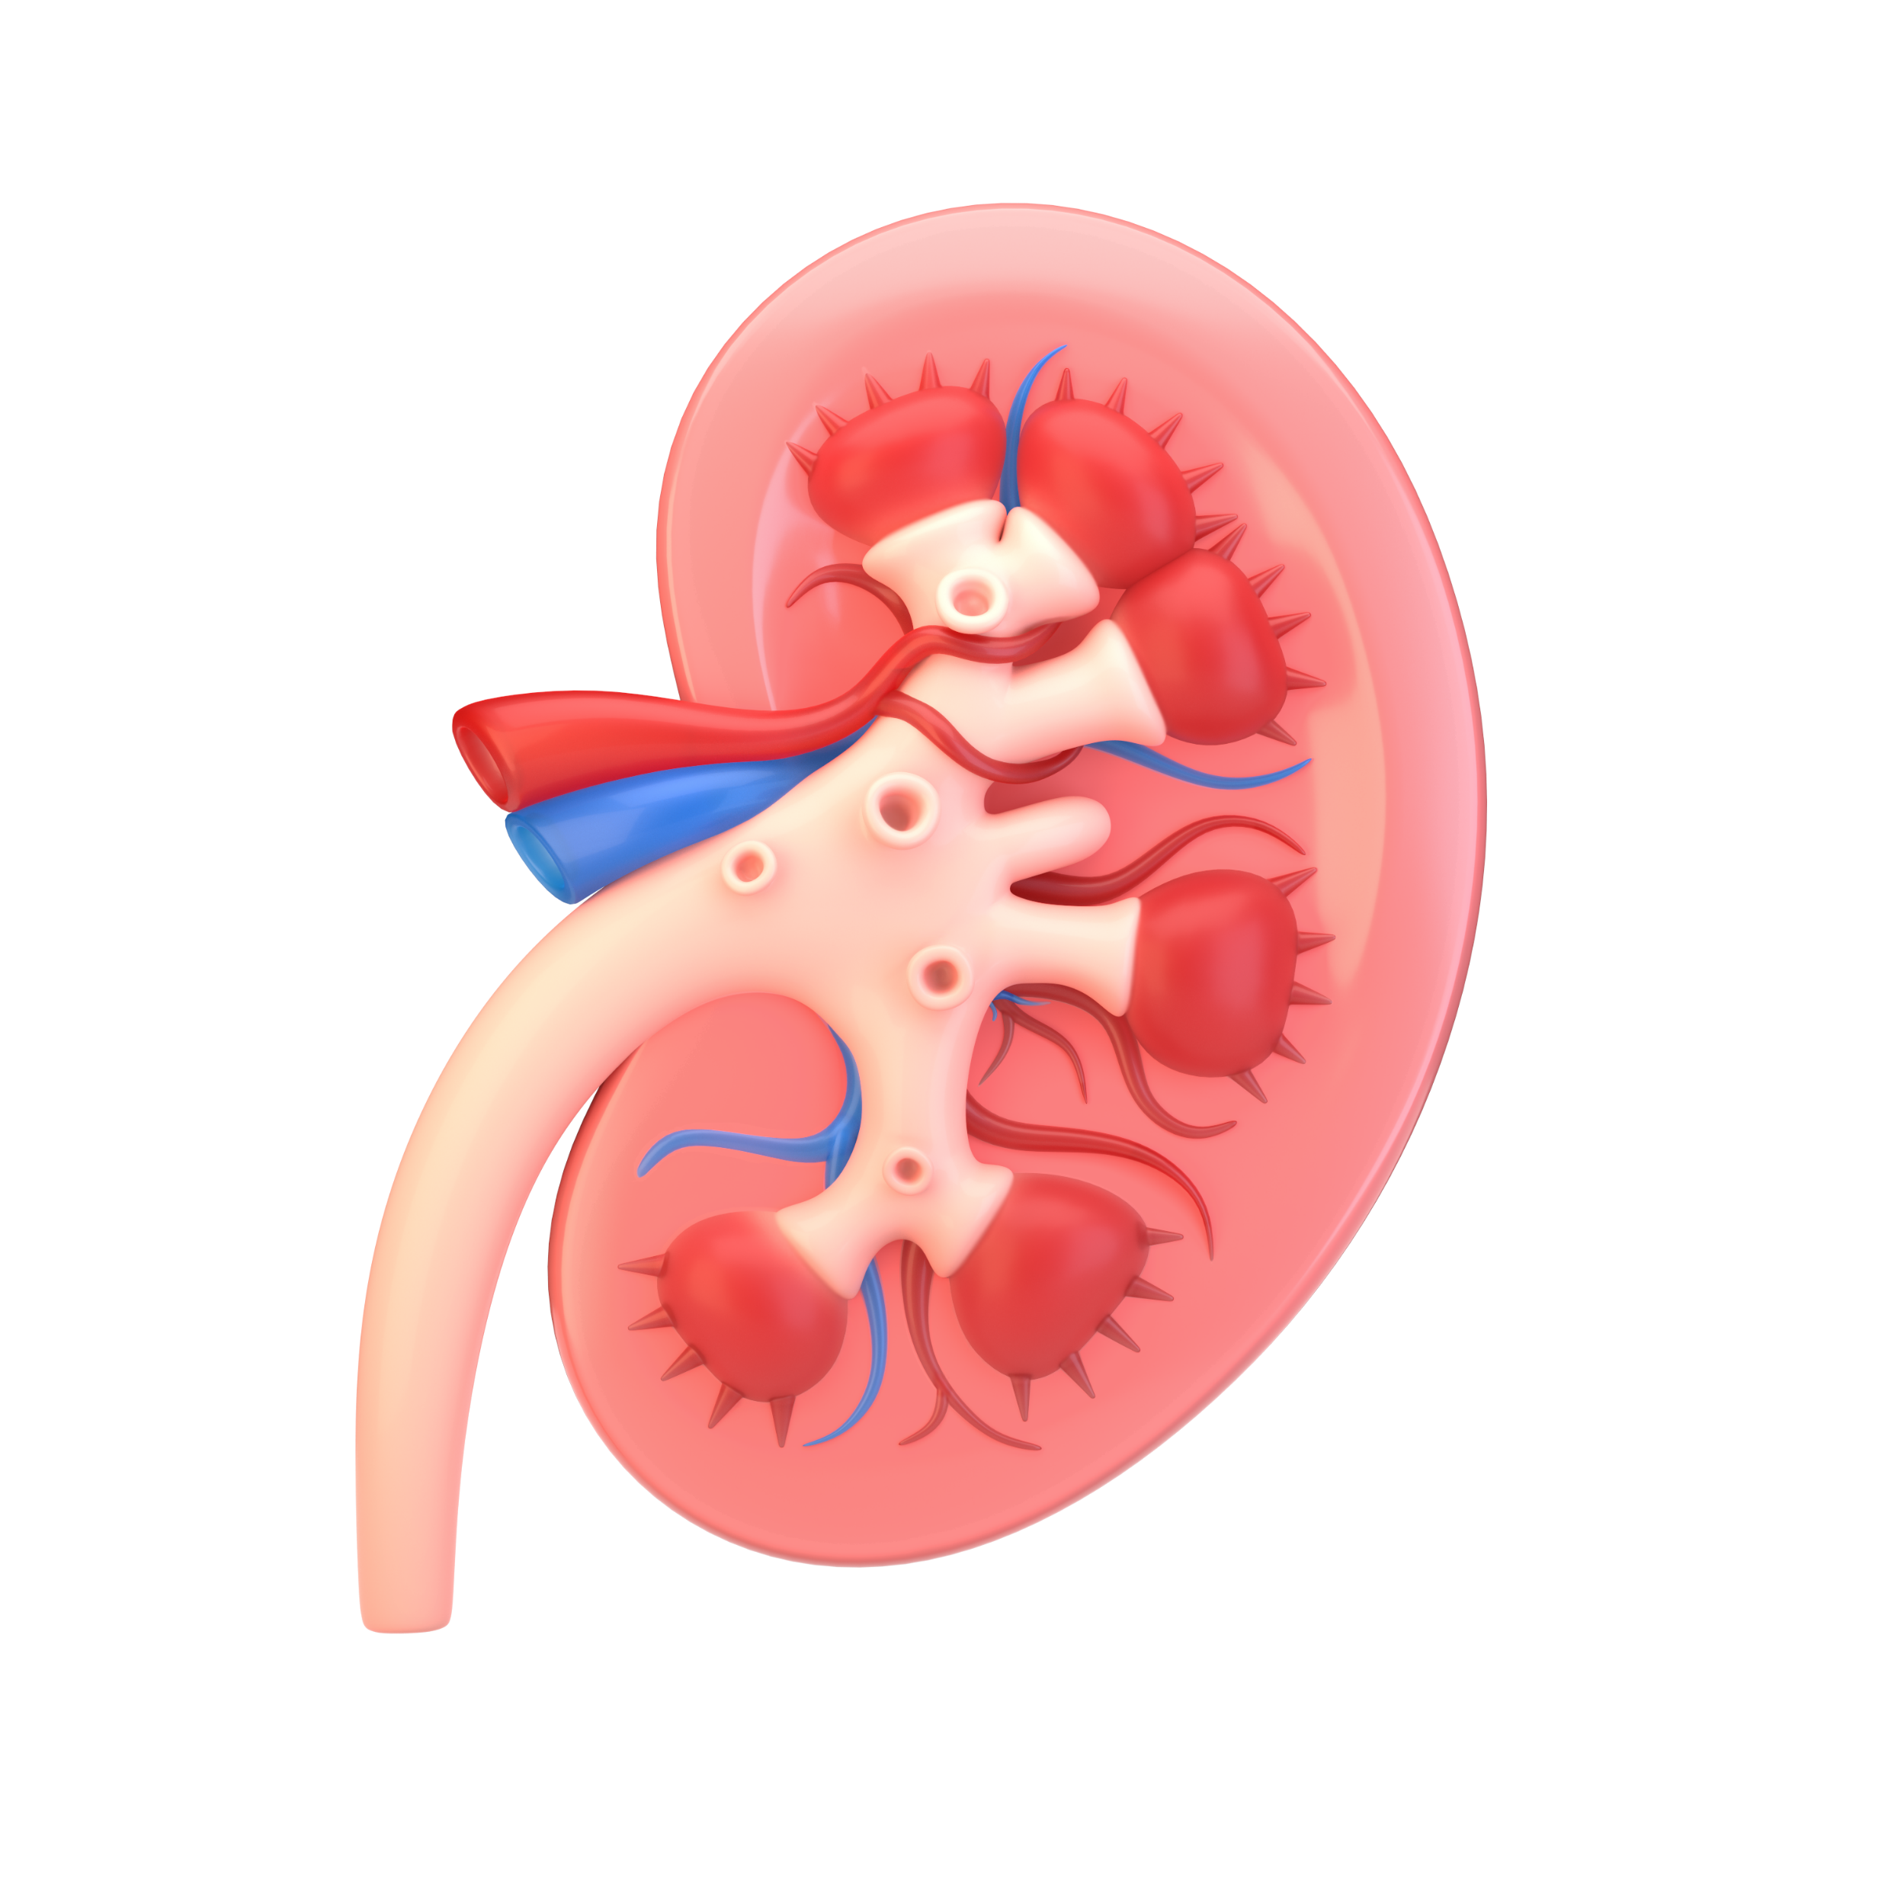
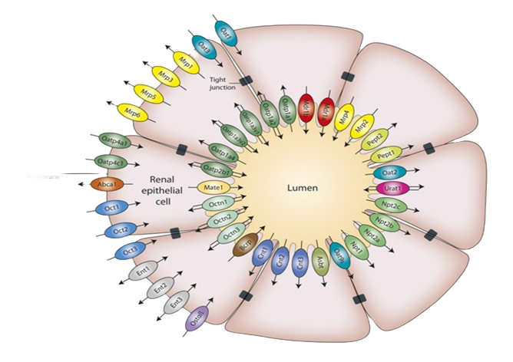
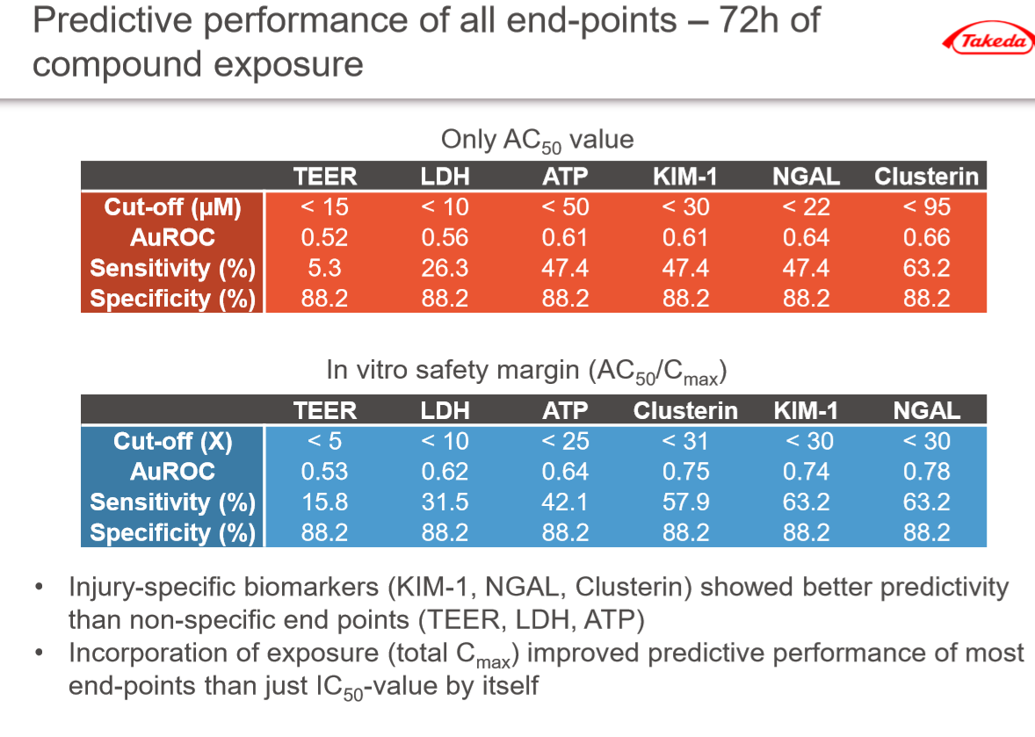
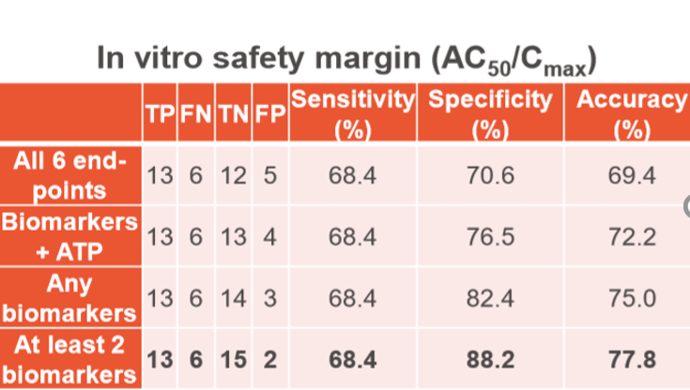




aProximateTM: A predictive in vitro primary proximal tubule platform for de-risking of antibiotic induced kidney injury
Keith Pye, Git Chung and Colin Brown
Newcells Biotech Limited, The Biosphere, Draymans Way, Newcastle Helix,
Newcastle upon Tyne. UK NE4 5BX
Introduction
aProximate Proximal Tubule cell monolayers express a full range of transport proteins and form tight monolayers when grown on Transwell filter supports
Nephrotoxicity is a major reason for drugs failing during clinical development.
Currently there is no in vitro platform that enables cross-species comparisons of drug transport or nephrotoxicity.
Our innovative solution is to develop highly differentiated assay platforms using primary renal proximal tubule cells(PTCs) derived from key animal species to measure both drug transport and drug induced kidney injury a range of biomarkers across species
Here we showcase data from our highly differentiated Human proximal tubule model
Lumen
Filter
Blood
Cell Monolayer
aProximate Proximal Tubule cell monolayers express a full range of transport proteins and form tight monolayers when grown on Transwell filter supports
Methods
Results
Proximal Tubule cell monolayers express a full range of transport proteins and form tight monolayers when grown on
PTCs were isolated from fresh Human kidneys and cultured onto Transwell inserts
Test toolkit was made up of a compounds with known nephrotoxicity liability and clinical data were screened using the model Toolkit was made up of 19 Primary PT-toxic and 17 Secondary PT-toxic (3) or non-nephrotoxic (14) compounds
Aminoglycoside test toolkit included Neomycin, Tobramycin, Gentamicin, Amikacin and Streptomycin
Monolayer were exposed for 72 hours to a range of concentrations (0-300µM) of test compound
Toxicity was measured used 6 parameters of cell health: Transepithelial Resistance (TEER), Intracellular ATP concentration, LDH release , KIM-1 release, Clusterin release NGAL release
Biomarkers were measured on an MSD platform
ATP was measured using a Promega CellTiter Glo2 assay
LDH was measured using a Promega LDH-glo assay
Renal Biomarkers Response in aProximate™ PTC cells is Polarised and Correlates with Exposure to Nephrotoxin
Renal Biomarkers Response to Aminoglycoside Challenge
Gentamicin Uptake Cisplatin Uptake
coating 1
Gentamicin Biomarker release Cisplatin Biomarker release
coating 2
Gentamicin is predominately taken up across apical membrane. Only apical exposure to gentamicin elicits release of biomarkers of damage.
Cisplatin is predominately taken up across basolateral membrane. Only basolateral exposure to cisplatin elicits release of biomarkers of damage.
Inhibition of Gentamicin Uptake reduces Biomarker response to Gentamicin
Cells were challenged with either cisplatin (10цM) or a range of aminoglycosides (3000цM) for 72 hours.
Significant increases in KIM-1, NGAL and Clusterin were found with exposure to Neomycin, Tobramycin and Gentacin. In contrast, challenge with streptomycin had no significant effect on biomarkers production
Inhibition of gentamicin uptake by inhibitors of megalin, cubulin result
in a significant reduction in Biomarker release
Results
Validation of aProximate™ PTC monolayer as a Predictive model of Toxicity
Compound 6
Compound 6
Compound 24
Injury specific biomarkers were more predictive than non specific endpoints (TEER, ATP depletion, LDH release)
In vitro safety margin (AC₅₀/C_{max}) was more predictive than AC₅₀ alone
Best Predictivity came from combination of two biomarkers
Compound 24
Cells were challenged with either gentamicin (200цg/ml) or cisplatin (10цM) for 72 hours.
Biomarkers are were found only in the apical media.
This corresponds to the in vivo release of biomarkers into the urine
Effect of a non toxic (compound 6) and toxic (compound 24 upon endpoints measured
Conclusion
Human proximal tubule cell monolayers retain a remarkable degree of differentiation and express a range of functional transporters and clinically relevant biomarkers of nephrotoxicity that are sensitive to nephrotoxin challenge over time. Human PTC monolayers show excellent potential as an in vitro predictive screening platform.
Further details available online or contact us at enquiries@newcellsbiotech.co.uk

